Slide 1
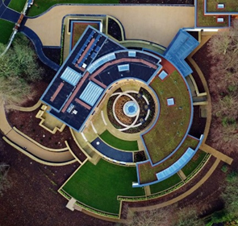
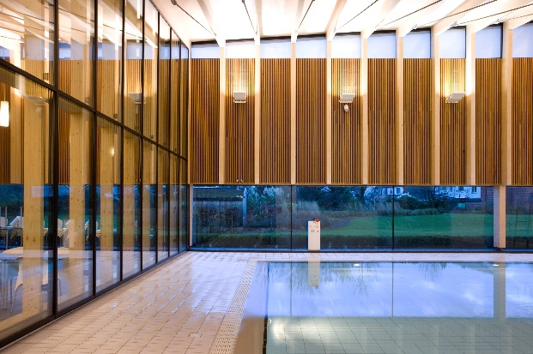
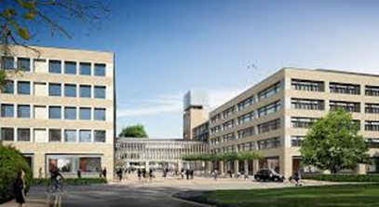
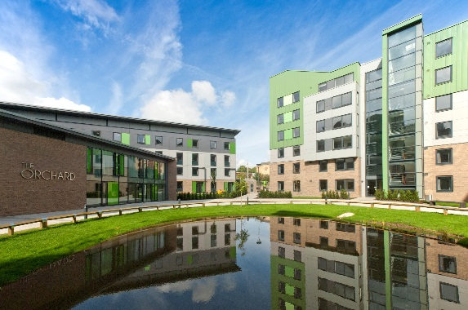
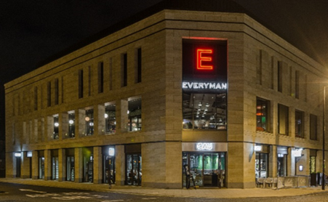
Spring and Company
“A Refreshing Approach to Development Partnering”
Spring and Co was formed in the depths of the recession in January 1992 after a previous life in main contracting with Tarmac, Balfour Beatty and Turriff Construction.
Our total focus is on satisfying Clients needs with a hands on pragmatic common sense approach to achieve a successful outcome.
Through this approach Spring and Co have attracted an enviable record of repeat business with Clients of excellent standing such as Aviva Investors, Kames Capital, RDI Reit, Dr Terry Bramall and family, 4Urban, NatWest Bank, The Royal Bank Of Scotland, One Medical Group, Turner & Townsend, Aintree University Hospital NHS Foundation Trust, Cumbria Partnership and MTX Contracts.
Spring and Co provide services to the development and construction delivery process from that initial requirement through to completion, occupation and facilities in use.
“Remarkably Tried & Trusted in Construction & Property since 1992”
www.springandco.co.uk
Spring & Company - Delivering Successfully

Slide 2
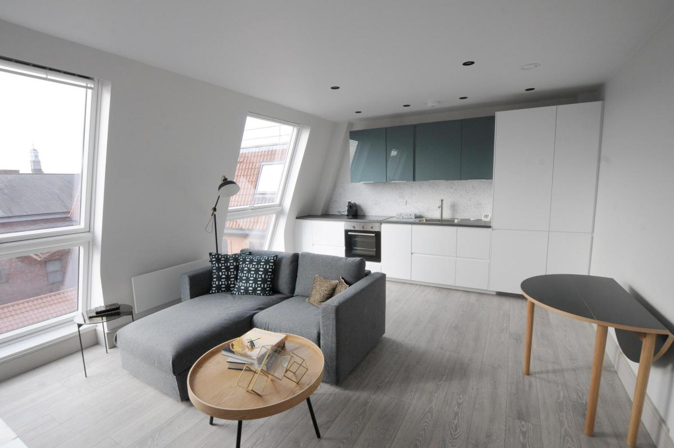
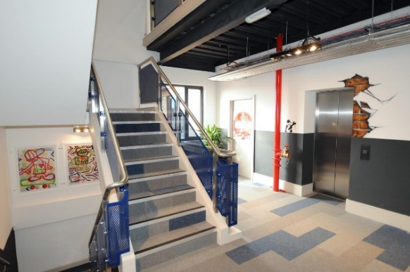
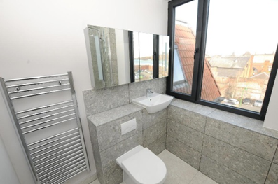
Kings Court, Warrington
“The Perfect Regeneration Partnership”
This development is a bold plan to solve the conundrum of empty and out dated office buildings that can be seen in the centre of towns just like Warrington.
This is a huge dilemma that faces local authorities across this land. Not only is it a property that has come to the end of its useful life however the bigger issue is what needs to be done to revive its fortunes and contribution to the local community.
Therefore Spring and Co were delighted to join forces with Emerald Bay to convert a redundant office block in Warrington Town centre to residential apartments.
The works involved stripping out the old interior and replacing them with a mix of 32 one and two bed apartments for the private rental market at the heart of the town centre with easy access to public transport including the main line railway and transport interchange.
To add to the mix there are commercial outlets on the ground floor giving a true mixed development.
This is a perfect example of how to deliver the much needed town centre regeneration every local authority craves for.
Spring & Company - Delivering Successfully

Slide 3
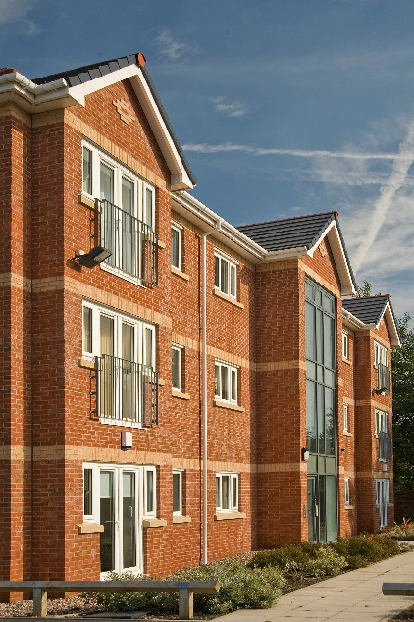
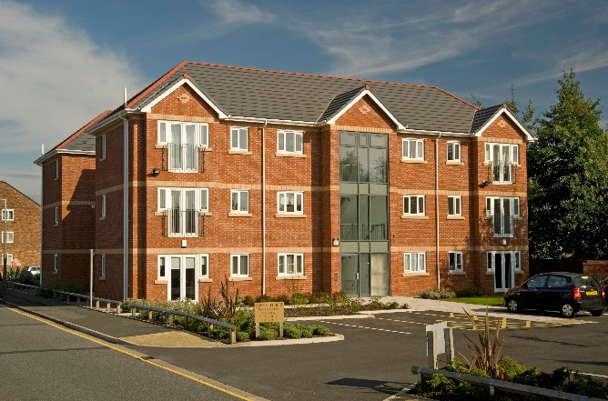
Ashfield Court, Warrington
“A True Joint Venture”
This is a residential development of apartments in St Helens as a fore runner of the Private Rental Sector on a site owned by Emerald Bay.
Spring and Co joined forces with Emerald Bay in a joint venture to take the development through the pre-construction process to arrive at a detailed planning consent that worked for all concerned and to secure senior debt funding with the NatWest Bank.
Spring and Co took on the delivery role in the capacity of main contractor to deliver a successful development in which both parties still have an involvement.
Spring & Company - Delivering Successfully

Slide 4
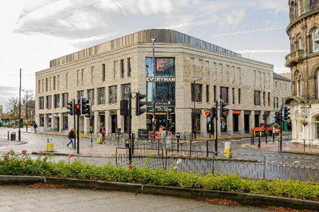
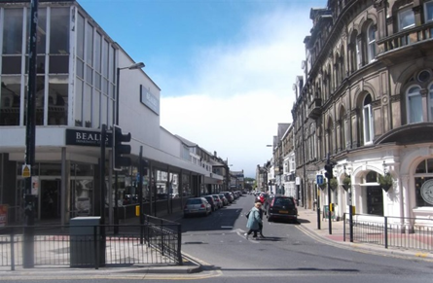
Albert Street, Harrogate
“Classic Town Centre Regeneration”
This is a story of taking an old department store that had seen better days and replacing it with a new state of the art cinema complex including the associated dining and leisure facilities that cascade down.
This is a difficult town centre location with live occupied properties on two sides and busy streets on the other two sides. The scheme included the cinema, several restaurants and residential apartments.
Spring and Co joined the team from the very outset to play a lead development partnering role in carrying out the necessary feasibility study to confirm the scheme’s viability. As well as working through the normal pre-construction process there was the opportunity to carry out the all-important condition, contamination and site surveys and negotiations with the anchor tenants.
The project team, including the designers, were chosen allowing the planning permission to be processed through to receiving the necessary consents including compliance with the local plan in conjunction with the detailed design in keeping with the stringent local requirements.
In conjunction with this Spring and Co worked up the live costs to arrive at a completed contract enabling Spring and Co to take on the role of delivery partner under a design and build contract.
The development was completed including allowing early access for the fitting out of the Cinema and the associated units and external works.
This was a classic town centre redevelopment that has reinvigorated an important part of the market town of Harrogate.
Spring and Co are very proud of this development and the part they played to turn it into a huge success.
Spring & Company - Delivering Successfully

Slide 5
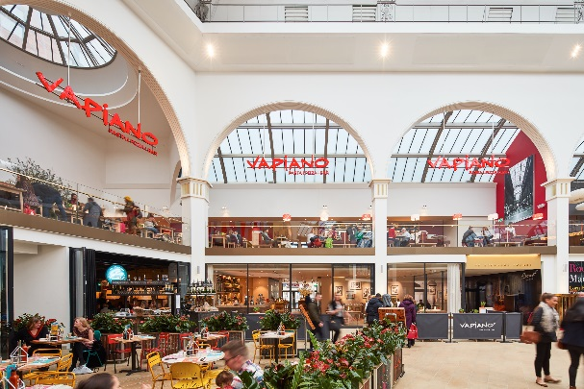
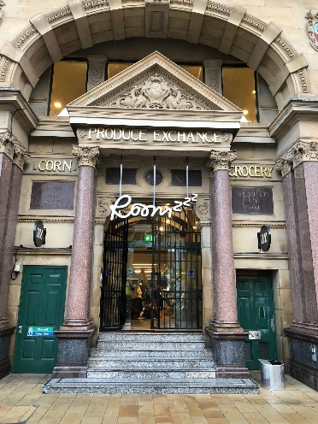
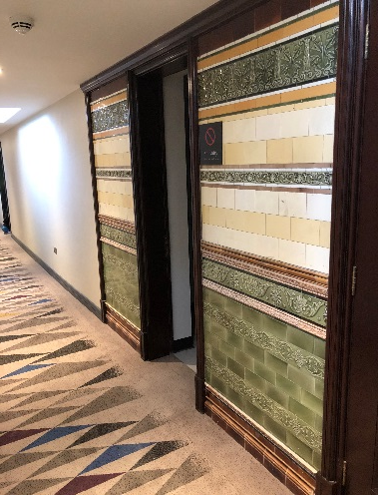
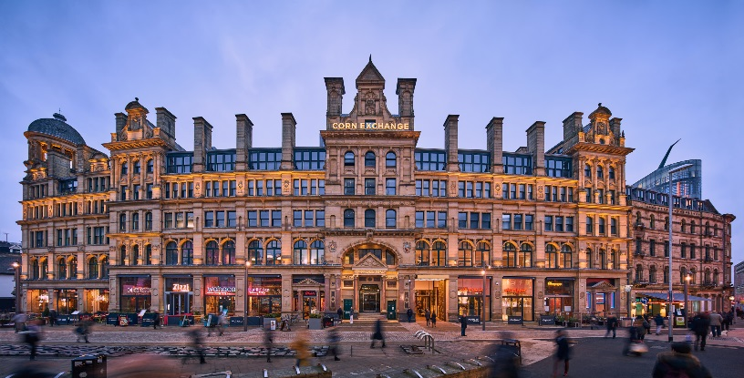
Corn Exchange, Manchester
“Transformational”
This is an iconic Grade 2 listed building at a major cross roads in the heart of the City of Manchester which in its time as the Triangle has gone through several significant phases of its long life. For many years it was an oasis to escape the hurly burly of city centre where you could enjoy a coffee with something to eat or shop in those boutique retail outlets on the lower floors whilst the upper floors provided very convenient and quaint office accommodation.
Back in the noughties, Spring and Co were invited by Aviva Investors to prepare a quick and dirty options study to consider what they could do to recover the fortunes of this historic building after its recent purchase.
After many years of seeking the secret to restoring its fortunes in a fast moving city centre it was agreed to deal with the redevelopment in three succinct phases. The first one being the rebranding to the Corn Exchange which ironically was its original purpose and use; phase 2 being the conversion of the lower public areas into dining outlets given its strategic location adjacent to the Manchester Arena and the Northern Quarter; and thirdly the conversion of the upper floors into a Boutique Aparthotel.
The third phase was completed in 2018 and the rejuvenation of this grand old was complete and it is now enjoying a new lease of life.
Spring and Co are very proud to have been there all the way in this great success story and to have played a significant part throughout.
Spring & Company - Delivering Successfully

Slide 6
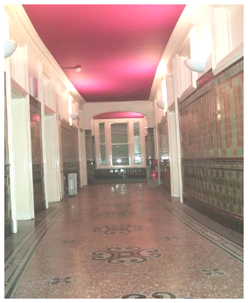
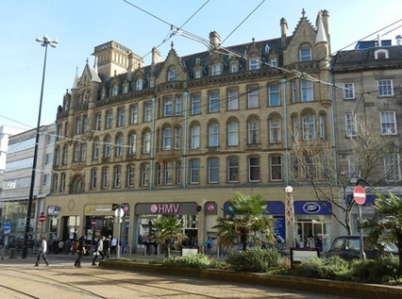
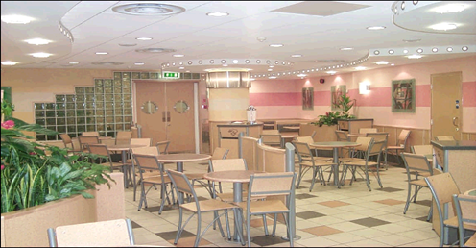
High Street, Sheffield
“The Job That Couldn’t Be Built”
This is all about taking an old grade 2 listed building and regenerating it to meet the modern needs of a major city centre island site. The development site was surrounded by properties making it effectively a land locked site with the tram running down the full length of the front elevation.
This was a classic development model given the need to achieve cost certainty, time certainty, the requisite number of prelets, statutory compliance in terms of obtaining planning permission and listed building consent, a coordinated detailed design, knowledge of the site and legal compliance to allow it to go unconditional.
The works were carried out in two phases with phase one being all the structural alteration works to provide new retail units for the anchor tenants. The second phase being the conversion of the upper floors to form apartments for rental purposes.
Spring and Co were invited to join the team by Aviva from the outset of the development process to provide greater certainty in terms of costings, knowledge about the site, site logistics, team selection and appointment, project management, construction issues and delivery timescales as well as securing the necessary permissions and managing the interface with the neighbours.
Having achieved the unconditional status Spring and Co took on the Construction Management role and delivered the first phase to be followed the conversion and fitting out of the upper floors to form much sort after city centre apartments.
All in all a very successful and fulfilling development.
Spring & Company - Delivering Successfully

Slide 7
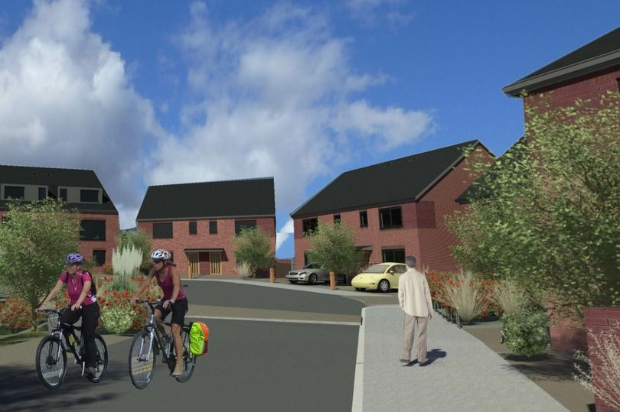
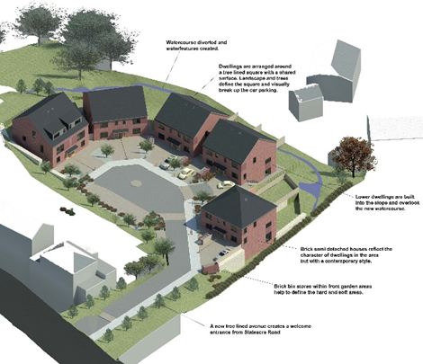
Slateacre Road, Gee Cross, Hyde
“A Classic Development Partnership”
The owners of a lump of scrub land in a much desired area of East Manchester had been wondering what to do with it for many a year when Spring and Co were introduced to them nearly there years ago. The same owners had won a hard fought battle to obtain a far from perfect planning consent.
Spring and Co teamed up with the owners to review the proposals to establish whether there were the makings of a development opportunity. In their capacity as development partner with specific responsibility for its delivery Spring and Co rejigged the scheme to make it more attractive and obtain planning permission.
In parallel with the detailed planning process the senior debt funding from the Greater Manchester Housing Fund was secured to allow the development to go unconditional in November 2018. This is not an easy site with there being resident badgers, Himalayan Balsam and American Skunk Cabbage as well as constantly flowing water course through an old quarry site.
Nonetheless Spring and Co have taken this development to site and are in the process of delivering it as the main contractor and delivery partner to provide a cul-de-sac development of 10 highly desirable family houses
Spring & Company - Delivering Successfully

Slide 8
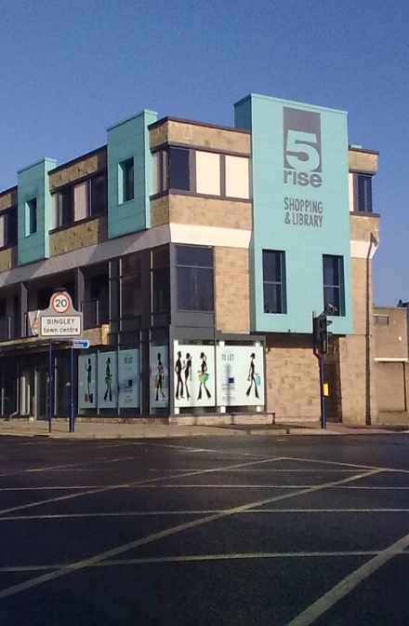
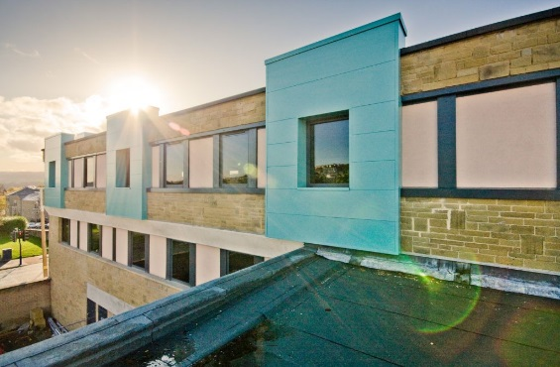
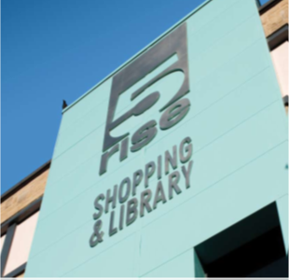
5 Rise Bingley
“Town Centre Redevelopment In A Live Environment”
Spring and Co were appointed by the Client as a development partner with a view to redeveloping the town centre of Bingley to form a mix of residential, retail, leisure, civic and public amenities.
Spring and Co worked from the early stages to consider the options and the implications of them in turn by providing valuable input into the costings, timescales, buildability and logistics for each of the options before locking in to the final scheme as well as project managing the pre-construction phase of the development.
Upon selection of the preferred scheme they worked up the detail to arrive at a final detailed scheme as well as establishing the final costs, programme and logistics plan which allowed the award of the building contract.
Spring and Co went on to carry out the role of main contractor through a design and build form of contract to successfully deliver the works to the satisfaction of all.
The key features being maintaining the retail tenants insitu and the relocation of the public library to keep it operational throughout. The works included part demolition and structural strengthening works for future extensions.
Spring & Company - Delivering Successfully

